Slide 1
Development of Chat-3 Model for Enhanced Human-Computer Conversations

Slide 2
Aims and Objectives of Chat-3
Aim: Make a smarter talking computer that understands us better
Objectives:
Teach Chat-3 to keep track of what we're talking about.
Help Chat-3 reply in a way that makes sense and feels natural.
Make sure Chat-3 talks nicely and doesn't say anything wrong

Slide 3
Introduction
Welcome! Today, we're diving into a world where machines can talk and understand us.
Meet Chat-3, a brand-new AI marvel that's changing the game in talking with computers.
Chat-3 isn't your average chatbot. It's smarter and more real.
A future where machines truly understand and respond.

Slide 4
Abstract
Imagine talking to a computer that understands you as well as a friend. That's what Chat-3, our new chatbot, aims to achieve.
This paper introduces Chat-3, explaining why we made it, what it can do, and how it performed. By using fancy language skills, Chat-3 makes conversations more natural and enjoyable, making it useful for things like customer service and friendly chats.

Slide 5

Rationale:
Evolution of Conversational AI
Existing Model Struggles
Introducing Chat-3
Human-like Responses
Addressing Limitations:

Slide 6
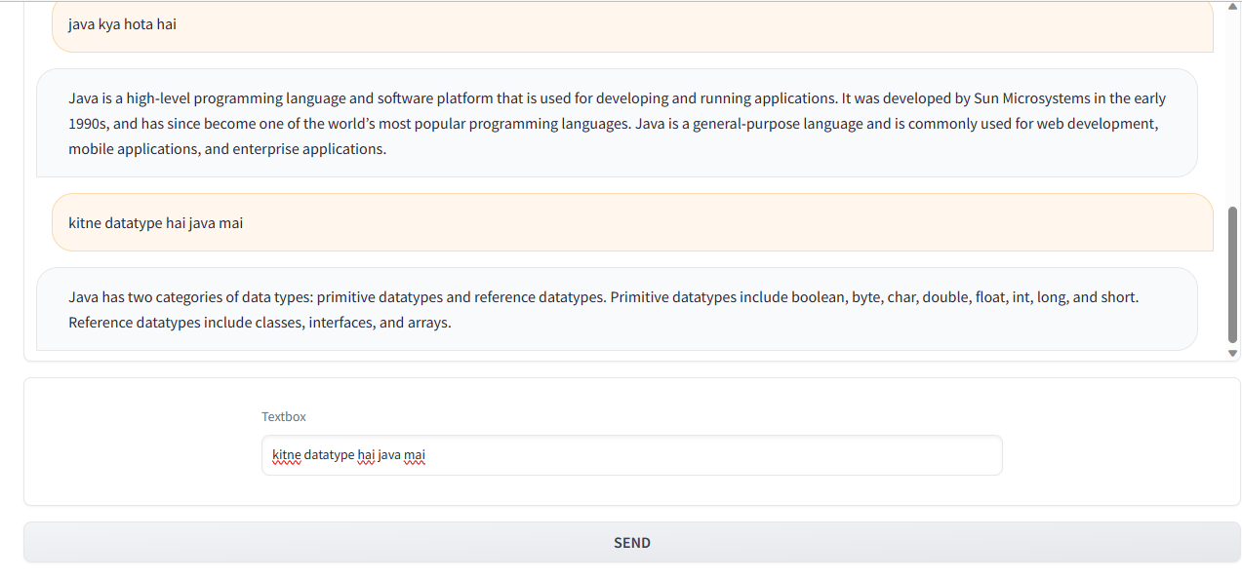
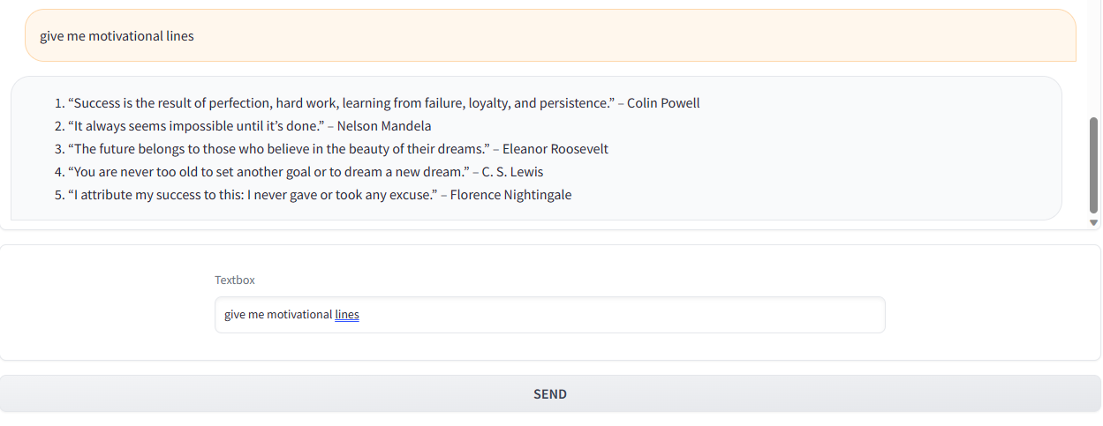
WORKING ON CHAT GPT -3 Model:-
Phase 1:
Phase 2:

Slide 7
Real-Life Example:
Customer Segment:-
Imagine you're chatting online with a customer support bot about a product issue.
With older bots, you might need to repeat your problem because it forgets what you said earlier.
But with Chat-3, it remembers the whole
conversation, so you don't have to repeat
yourself.

Slide 8
Result:
Results: After working hard on Chat-3, it got better at remembering what we talk about and giving good answers.
People Liked It: When people tried Chat-3, they liked it more than older chatbots. It felt like a real conversation.
Chat-3's Role: Chat-3 is a big step toward making computers talk like humans.

Slide 9
Conclusion:
Exciting Progress: Chat-3 shows we're moving in the right direction in making computers understand us better.
Human-Like Chats: It proves that computers can have better conversations with us, like real friends.
Future Ahead: With Chat-3's success, we're excited about more cool stuff in AI's future.

Slide 13
Add a Slide Title - 4

Slide 14
Add a Slide Title - 5

